Slide 1
CS 2001 Data Structures
Week 3
Lecture 3

Slide 2
Example to understand Backtracking

Slide 3
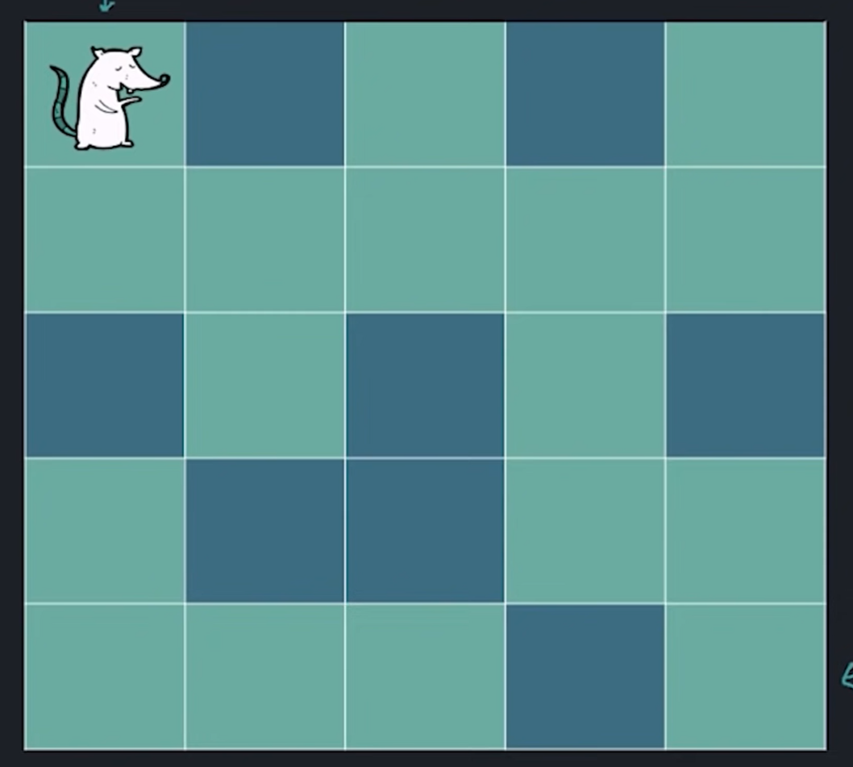
Rat in a maze

Slide 4
Input:
0 denotes wall, 1 denotes free path
two numbers n, m
Next n lines contain m numbers (0 or 1)
Output:
Print 1 if rat can reach (n-1,m-1)
Print 0 if it can not reach (n-1,m-1)
Test Case 1:
Input:
5 5
1 0 1 0 1
1 1 1 1 1
0 1 0 1 0
1 0 0 1 1
1 1 1 0 1
Output:
1

Slide 5
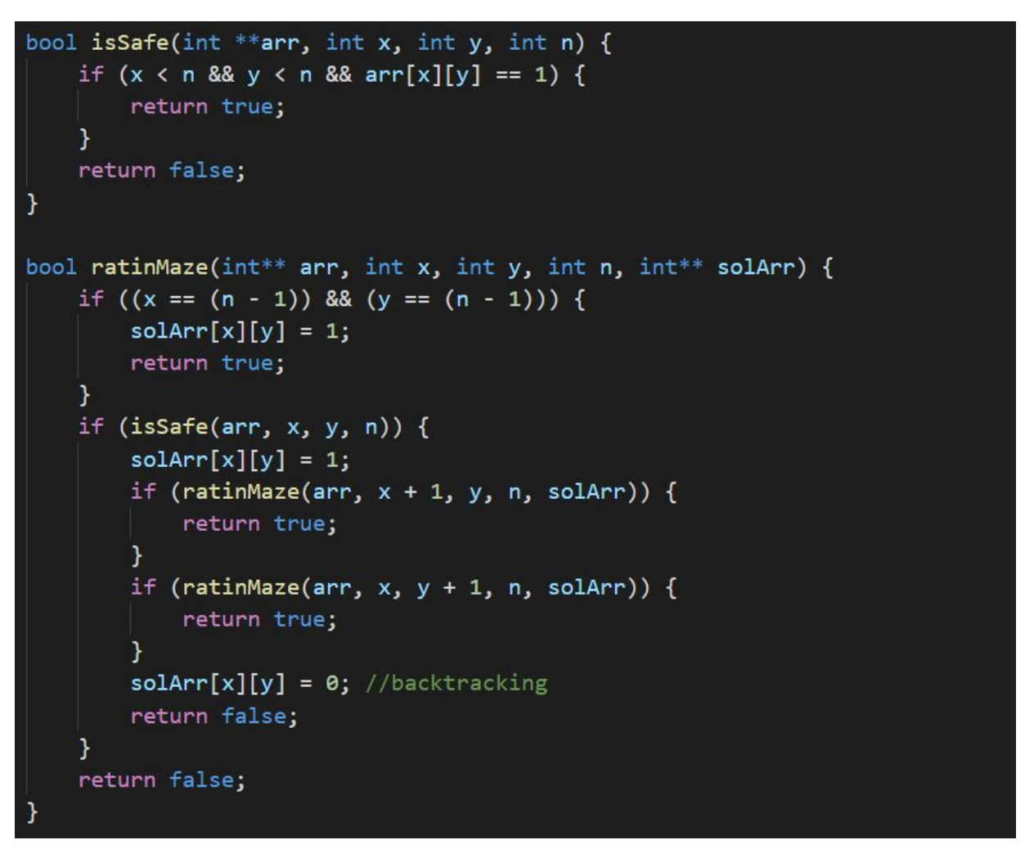

Slide 6
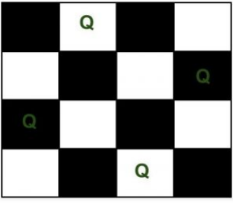
N-Queen Problem
We have N queens and N x N chess board. The objective of this problem is such that we need to place all N queens on N x N chess board in such a manner that no two queens in under attack to each other.
Legal move attacking means no 2 queens in same row, col, and diagonal
Two queens will be under attack if one of the following conditions is true:-
firstly, if they are in the same row.
secondly, if they are in the same column.
finally, if they are in the same diagonal.

Slide 7
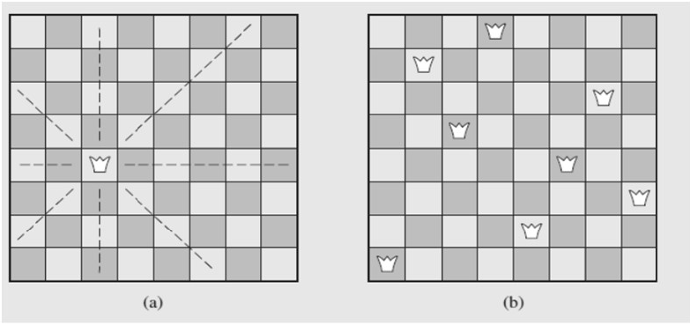
N-Queen Problem
Idea of the size of the problem:
There are 4,426,165,368 ways to arrange 8 queens on a chessboard of 64 squares.
No queen can reside in a row or a column that contains another queen
only 40,320 (8!) arrangements of queens to be checked for attacks along diagonals

Slide 8
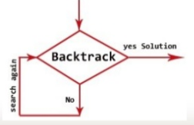
Back Tracking
Backtracking is an algorithmic technique for solving problems recursively by trying to build a solution incrementally, one piece at a time, removing those solutions that fail to satisfy the constraints of the problem at any point of time.

Slide 9
Backtracking Algorithm
The idea is to place queens one by one in different columns, starting from the leftmost column. When we place a queen in a column, we check for clashes with already placed queens.
In the current column, if we find a row for which there is no clash, we mark this row and column as part of the solution. If we do not find such a row due to clashes then we backtrack and return false.

Slide 10
Backtracking Algorithm
Start in the leftmost column
If all queens are placed
return true
Try all rows in the current column. Do following for every tried row.
If the queen can be placed safely in this row then mark this [row, column] as part of the solution and recursively check if placing queen here leads to a solution.
If placing the queen in [row, column] leads to a solution then return true.
If placing queen doesn't lead to a solution then unmark this [row, column] (Backtrack) and go to step (a) to try other rows.
If all rows have been tried and nothing worked, return false to trigger backtracking.

Slide 11
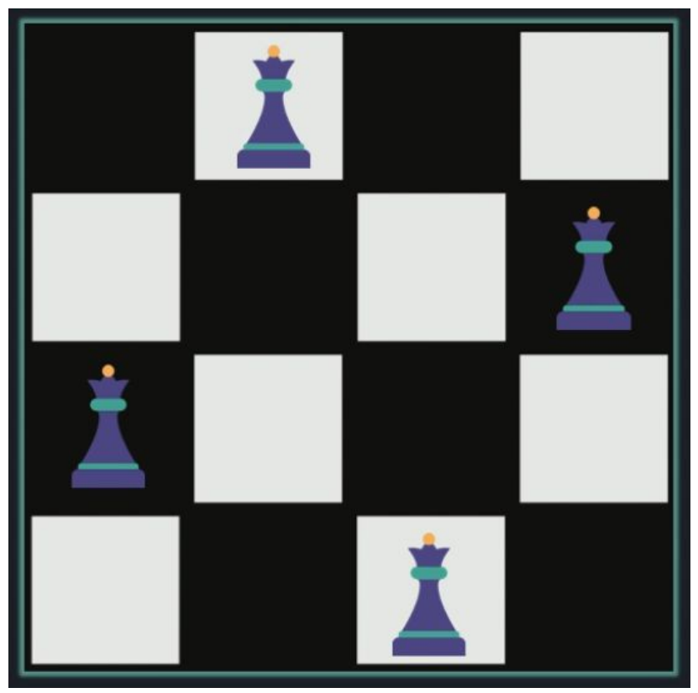

Slide 12
Input:
A single integer n
Output:
n x n matrix, where one denotes queen, and 0 for an empty cell.
Test Case 1:
Input:
4
Output:
0 1 0 0
0 0 0 1
1 0 0 0
0 0 1 0

Slide 13
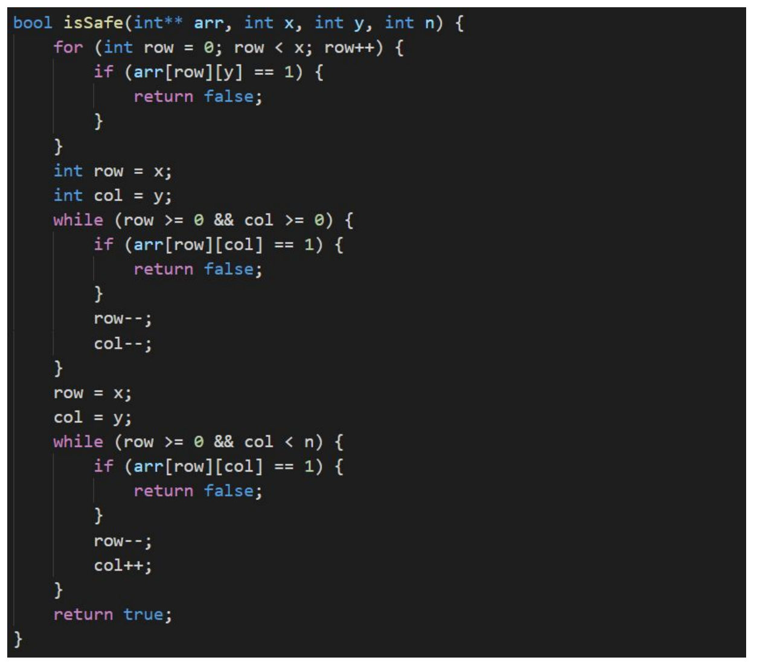

Slide 14
